Slide 1

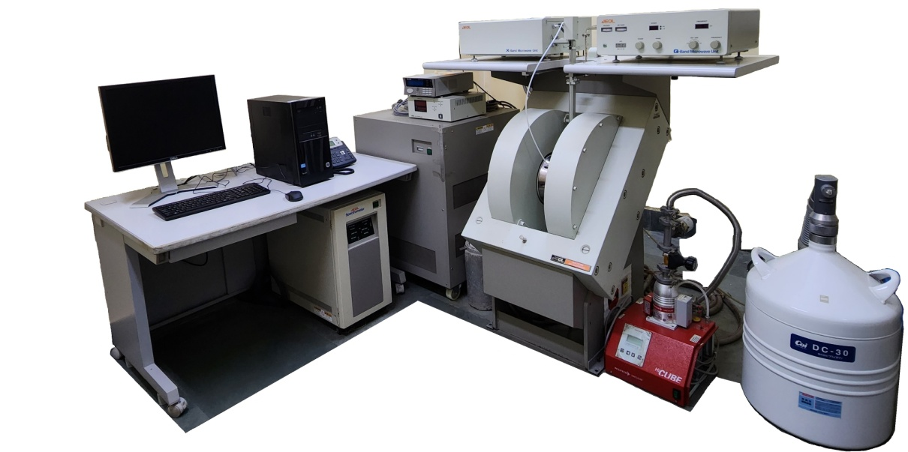


WELCOME
to the Workshop on
Electron Spin Resonance Spectroscopy and its applications
Date: 22nd February 2024
Venue : VMCC, IIT Bombay
Organized
By
SAIF/CRNTS,IIT Bombay
funded by IOE (Outreach & visibility)

