Slide 1

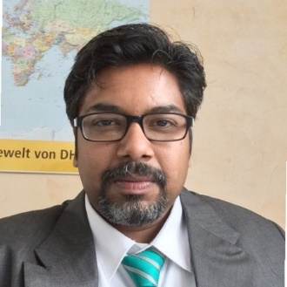
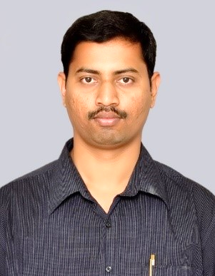
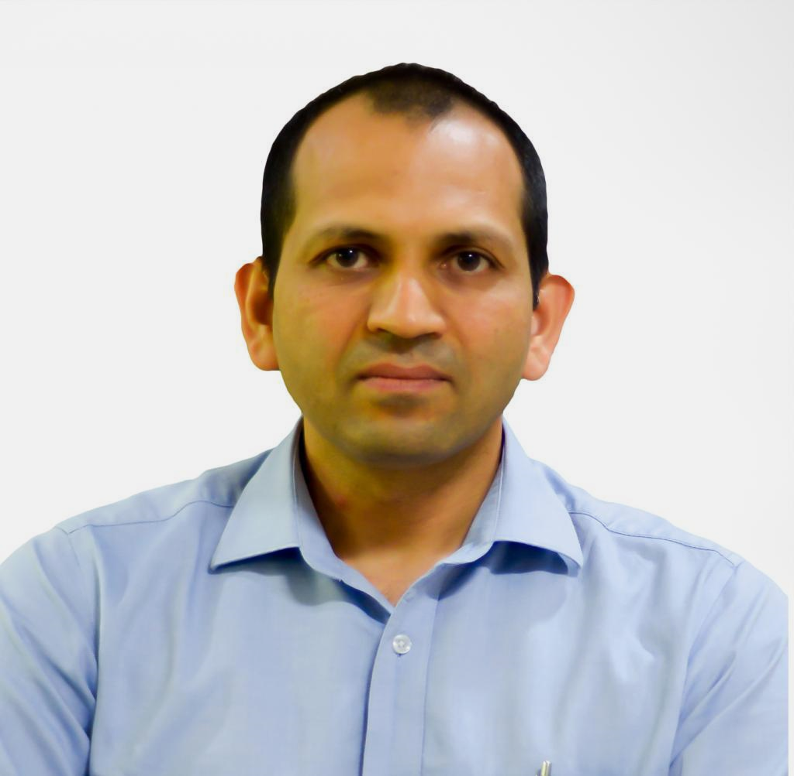
Centre for Research in Nanotechnology & Science/
Sophisticated Analytical Instrument Facility
IIT Bombay, India
Workshop on :
Dynamic Mechanical Analysis (DMA)
Basics and Applications
20th March (Wednesday), 2024
Venue: Hall No. 31, 3rd Floor, VMCC, IIT Bombay
Franklin Eden
Business Head
EDENWENZ Associates
Chennai, India
Prof. Prasanna Kumar S Mural
MEMS Department
IIT Bombay
Prof. Asim Tewari
Mechanical Engineering Department
IIT Bombay
Organizer: Prof. Suparna Mukherji Co-ordinator: Dr. Nutan Agadi
Head, SAIF/CRNTS with TGDTA-DSC Team
Workshop is funded by IOE (Outreach & visibility) grant

