Slide 1


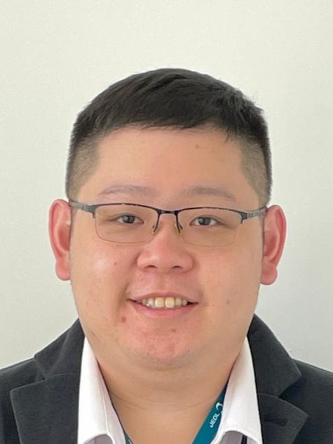
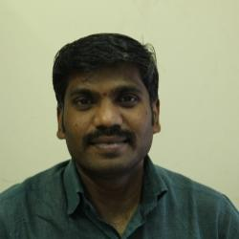
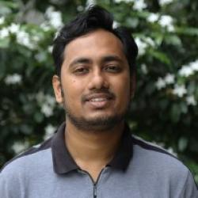
Centre for Research in Nanotechnology and Science (CRNTS)
Sophisticated Analytical Instrument Facility (SAIF)
Indian Institute of Technology Bombay, India
Workshop on Electron Spin Resonance (ESR) Spectroscopy
Organised by SAIF-IIT Bombay -Workshop is funded by IoE (Outreach & visibility) grant
Date: 22nd February, 2024 (Thursday)
Dr. Derek Yiren Ong
ESR Application Specialist
(JEOL Asia)
Topic: ESR basic and introduction of JEOL's ESR "JES-X series" and its application
Prof. Maheswaran S.
Department of Chemistry
IIT Bombay
Topic: Electron Paramagnetic Resonance of Transition metal ion complexes
Prof. Arnab Dutta
Department of Chemistry IIT Bombay
Topic: Elucidating reaction mechanism via ESR
Registration Link:
https://docs.google.com/forms/d/e/1FAIpQLScqhimZWvoEO8YDVI4PZeIG0Y4kBpSJ9hqgPqF4Ur_QsB7z-g/viewform?usp=sf_link

Slide 2
Workshop on Electron Spin Resonance (ESR) Spectroscopy
Organised by SAIF-IIT Bombay -Workshop is funded by IoE (Outreach & visibility) grant
Date: 22nd February, 2024 (Thursday)
Venue: Hall No. 31,3rd Floor, VMCC, IIT Bombay & SAIF, IIT Bombay
Workshop Schedule
9:15am – 9:45am | Registration
9:45am – 10:00 am | Prof. Suparna Mukherji Head-SAIF Welcome & Introduction of SAIF/CRNTS
10:00am– 11:00 am | Dr. Derek Yiren Ong ESR Application Specialist (JEOL Asia) Topic: ESR basic and introduction of JEOL's ESR "JES-X series"and its application
11:00 am – 11:15am | Tea break and interaction
11:15 am – 12:00noon | Prof. Maheswaran S. Department of Chemistry, IIT Bombay Topic: Electron Paramagnetic Resonance of Transition metal ion complexes
12:00noon – 12:45pm | Prof. Arnab Dutta Department of Chemistry, IIT Bombay Topic: Elucidating reaction mechanism via ESR
01:00pm – 2:00pm | Lunch break
02:00pm – 04:30pm | ESR demo session and SAIF laboratories visit
04:30pm – 05:00pm | High Tea and feedback session

